Slide 1

HEAD OF THE DEPARTMENT Dr. Ch. Venkata Phani Krishna (Professor & HOD) PROJECT COORDINATORS Dr. N. Venkatadri (Professor) Dr. Vadivelan Natarajan (Professor)
TEEGALA KRISHNA REDDY ENGINEERING COLLEGE
Department of Computer Science
and Engineering

Slide 2

GUIDE NAME TEAM MEMBERS M NAGESH G TEJASRI(16R91A0520) Assistant Professor K SHIVANI(16R91A0528) K SRIKRUTHI(16R91A0530)
-*-* PROJECT TITLE *-*-

Slide 3
OBJECTIVES
Abstract
Introduction
Existing System
Proposed System
Functional Requirements & Non-functional Requirements
Software & Hardware Requirements
System Architecture
System Modules
Conclusion & Future Works
References

Slide 4
ABSTRACT
Machine learning techniques have deeply rooted in our everyday life. However, since it is knowledge- and labor-intensive to go pursue good learning performance, humans are heavily involved in every aspect of machine learning. To make machine learning techniques easier to apply and reduce the demand for experienced human experts, application of automated machine learning has emerged as a hot topic with both industrial and academic interest. In this project, we try to implement some of the most common machine learning algorithms which actually perform decent on most kinds of data. This is a platform where even amateurs can utilise the power of machine learning algorithms to obtain quick regression and classification results. In simple words we can call it as a plug and play platform for simple machine learning problems

Slide 5
INTRODUCTION
We know machine learning finds its use in many of the technical and non-technical streams of the 21st century.
But at the same time its not knowledge and labour friendly to inculcate in any running infrastructure.
So to utilize the power of multiple machine learning algorithms we created a platform where the prediction and classification tasks can be performed on any type of data by just uploading the data to the platform.
This platform trains multiple machine learning algorithms on the uploaded data and at the same time checks the accuracy of the models.
The model with the best accuracy can then be used to predict the required results.

Slide 6
EXISTING SYSTEM
The existing system is incapable of running multiple algorithms at a time rather it works with only one algorithm at a time.
If multiple algorithms are required to run at the same time, that needs extensive coding thus it is not beginner friendly.
The existing system tend making use of the local system hardware making it less efficient.

Slide 7
PROPOSED SYSTEM
The proposed system overcomes the limitations of the existing system by enabling the working of multiple algorithms at the same time.
Since extensive coding is not required it also gets a beginner friendly approach.
Another limitation which the proposed overcomes is the hardware efficiency as it makes use of server side hardware.

Slide 8
FUNCTIONAL REQUIREMENTS
The system is required to run the selected algorithms on the uploaded data.
The generated accuracy results are to be compared and arranged in the best to worst order.
The data must be seen after upload for the final check.

Slide 9
NON-FUNCTIONAL REQUIREMENTS
The interface of the platform must be user friendly.
Portability is another important requirement.
Security is always a concern when dealing with data.
Reliability must not be compromised.

Slide 10
SOFTWARE REQUIREMENTS
Anaconda
HTML
CSS
Python (with Flask)
Sqlite

Slide 11
HARDWARE REQUIREMENTS
Windows 10
Intel i3 processor
10Gb of minimum storage
4Gb of minimun RAM

Slide 12
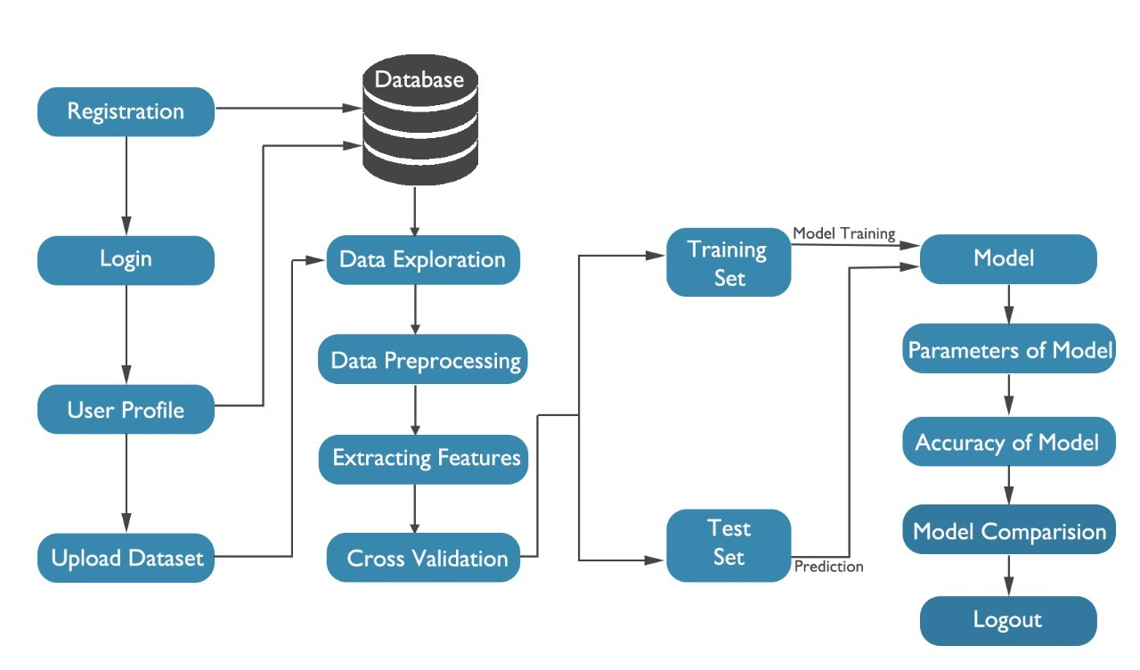
SYSTEM ARCHITECTURE

Slide 13
SYSTEM MODULES
Registration Module:- In this module the user is required to get registered with the platform to make use of the services offered by the platform.
Processing Module:- The data uploaded to the platform is fed to the algorithms for the processing.
Output Module:-The results obtained after the processing must be diplayed and to do so, this module is included. This module arranges the resultant accuracies in the best to worst order making it easy to interpret.

Slide 14
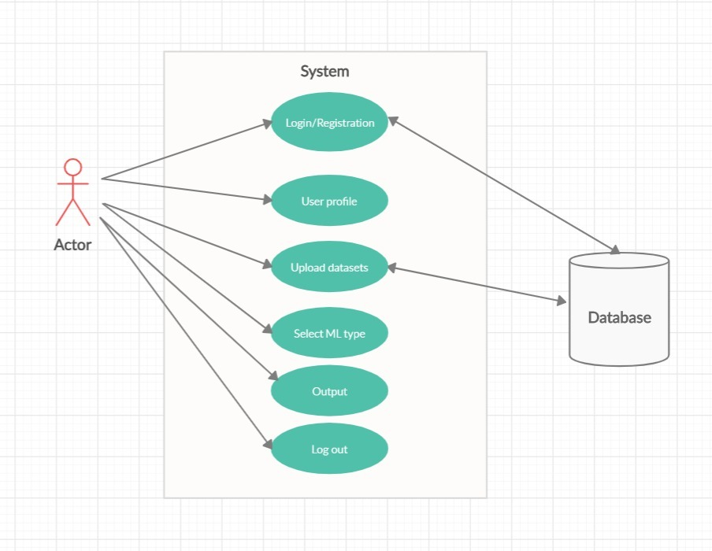
UML Diagrams

Slide 15
CONCLUSION & FUTURE WORKS
This platform offers a one stop shop for applying multiple algorithms on a common dataset, with just a couple of mouse clicks the accuracies of some of the most commonly used algorithms pop on the screen, making it easy to compare of the end user.
Future Works:-
We know there are a wide variety of algoritms available including deep learning modules, so these can be included aswell for the future works.
The feature of visualisation is also a scope to be included in future.

Slide 16
Any Queries?
Thank You…

